Slide 1
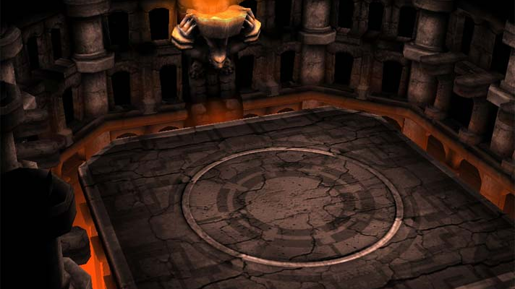
Terminal Application Project: Arena Battle Game Angel Lopez-Andrade Coder Academy 2019
Fig. 1. Generic battle arena from: “Battle Arena”, https://ga2dojo.fandom.com/wiki/Battle_Arena. Accessed 5 Sep. 2019.

Slide 2
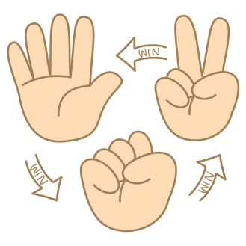
The initial idea
A classic ‘three-element chain’ battle logic based on the game ‘Scissors, Paper, Rock’
Fig. 2. Pictographic diagram of Scissors, Paper, Rock game logic from: “Rock, paper, scissors”, http://www.helpmykidlearn.ie/activities/5-7/detail/rock-paper-scissors. Accessed 5 Sep. 2019.

Slide 3
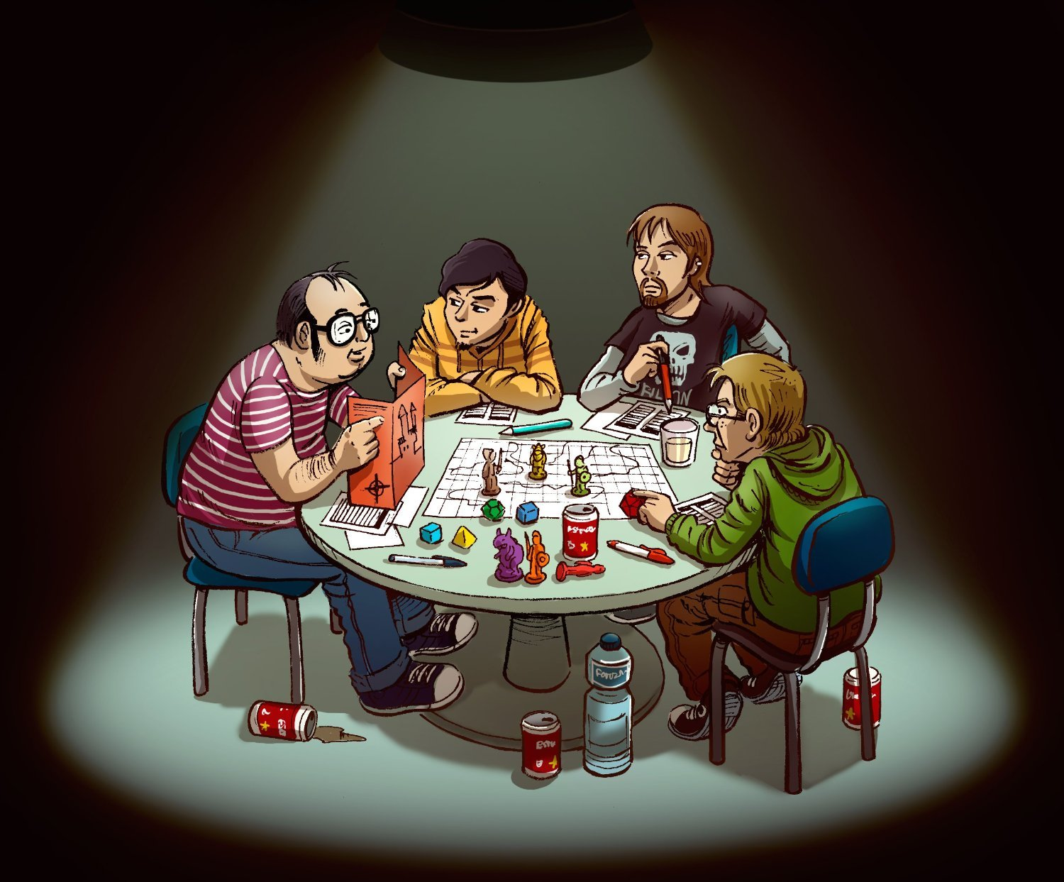
Some modifications to the battle system
Shift from a binary win/loss system to an incrementing damage system
Addition of ‘health points’, ‘turn-based’ actions, and increasing enemy difficulty progression from role-playing game concepts
Fig. 3. Four men playing a tabletop role-playing game from: “What’s Needed For A Roleplaying Game?”, 12 Nov. 2017, http://ubiquitousrat.net/?p=4333. Accessed 5 Sep. 2019.

Slide 4

Adding in some character
Free choice of player name
Character diversity
Announcer
Opponents
Character personality
Different colors for each character's speech
Set of randomly selected battle cries for each opponent
Fig. 4. Rainbow paintbrush from: “Paint windows: Paintbrush rainbow”, https://www.pinterest.com.au/pin/793900240537610604/. Accessed 5 Sep. 2019.

Slide 5

What I would change next time
Add an “attack” stat to all combatants that modifies damage done
Work towards incorporating the role-playing game principles of scaling difficulty and player upgrades
Clean up the index file by moving all announcer speech and combat logic into concise methods to be called from different files
Fig. 5. Pen and paper from: “The Value of Putting Pen to Paper in a Digital World”, https://themediahaus.wordpress.com/2013/06/06/the-value-of-putting-pen-to-paper-in-a-digital-world/, 6 Jun. 2013, Accessed 5 Sep. 2019.

